Slide 1
CIMB’s CDM Expansion
UAM Requirements

Slide 2
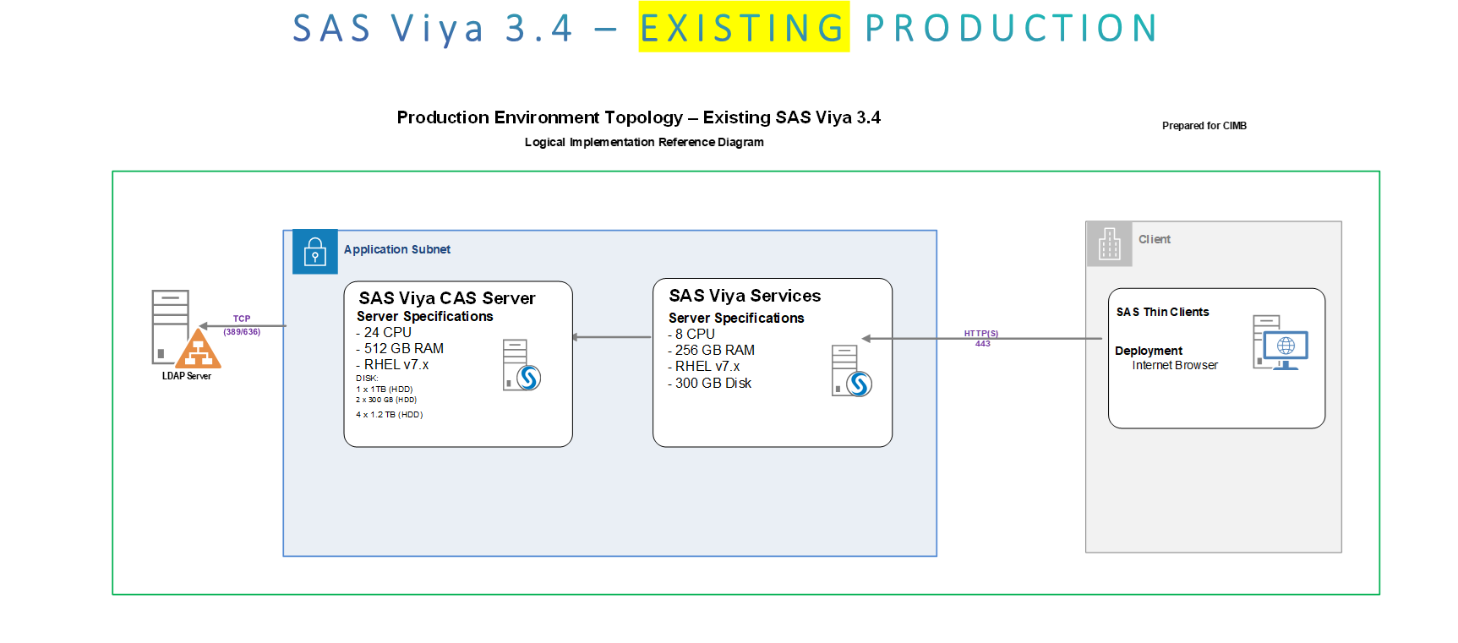
CIMB CDM-SAS Viya
Current Set-up and Process
User groups accessing – Consumer and Commercial Banking
SIBS and other external data used
Using SAS scripts to import csv to SAS datasets
Libraries and OS folders set-up by SAS last time as UAM (folder level access control).

Slide 3
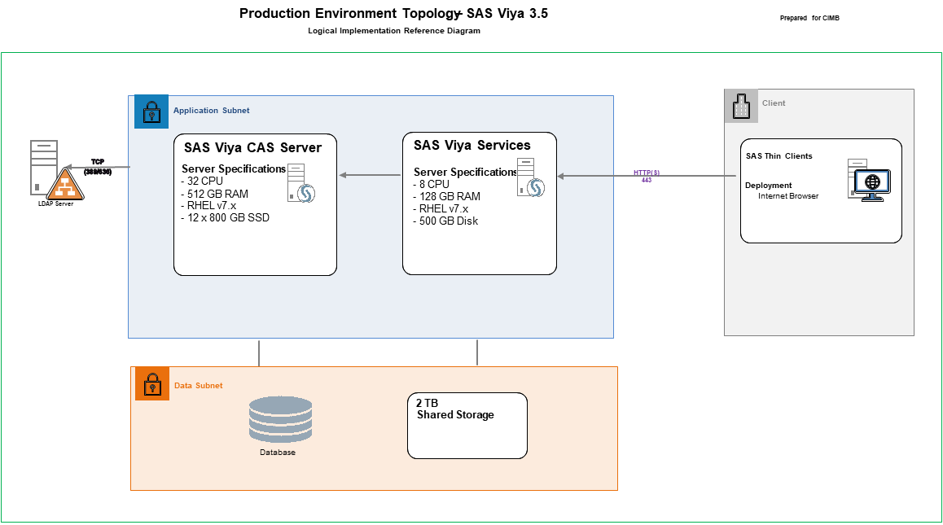
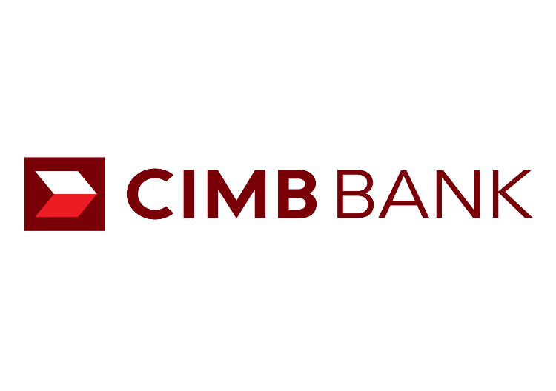
CIMB CDM-SAS Viya
Proposed Architecture
SAS Viya 3.5 Expansion Considerations:
35 TOTAL users and 20 CONCURTRENT users
Usable memory of ~435GB (CAS SERVER NODE will have total of 512GB RAM)
Average data size being accessed by users
Viewers and light users: 1GB-6GB
Power/advanced users: 3GB-6GB
6GB is the size of the largest table to be accessed as per CIMB
Notes:
On a high-level for SAS Viya, the server specs recommendation will be based on:
Total data to be lifted in-memory (CAS)
For users to perform visual exploration (for light users), machine learning development (for power users) the data needs to be on CAS
In the sizing document, we put 300GB as the total data to be loaded in-memory. This is based on attached email – “RE: kindly phase your question here”.
2. Current total in-memory usage – CAS Server – Maximum Average in %: 50.5 which is ~260GB we rounded up to 300GB
CIMB’s current Viya CAS Server is 24CORES and Memory is 512GB
Therefore EEC recommended:
For AWS – usable memory of ~460GB (WORKER NODES will have total of 480GB RAM, covering overhead for processing)
For on-premise distributed - usable memory of ~560GB (WORKER NODES will have total of 576GB RAM, covering overhead for processing)
For on-premise non-distributed – usable memory of ~435GB RAM (CAS SERVER NODE will have total of 512GB RAM, covering overhead for processing)
There are variations depending on the available processors’/instance’ specs. SAS provides minimum specs based on the inputs. If CIMB wants to add more core/memory/storage/etc then it would be better.
Number of concurrent users and role/activity type
Based on the inputs from CIMB there will be 35 TOTAL users and 20 CONCURTRENT users
Total advanced users - 15
Concurrent advanced users – 10
Using SAS Visual Statistics, Visual Data Mining and Machine Learning , Model Manager
Total light users - 20
Concurrent light users – 10
Using exploration on SAS Visual Analytics
Average data size being accessed by users
Based on the info, we have provided to EEC:
Viewers and light users: 1GB-6GB
Power/advanced users: 3GB-6GB
6GB is the size of the largest table to be accessed as per CIMB

Slide 4
CIMB CDM-SAS Viya
UAM Requirements
CDM as a data storage to cover all data needs by different Groups
Initial User Groups to on-board: 15+ Groups
SIBS is the primary data source
Structures will be fixed. If there are new columns, these will be on extension files
Data retention: 5-7 years of historical data as per regulatory requirements
CIMB identified 14 common raw tables used
covering main products
around 48GB in total size
Current and Saving product is covering 5 years; the rest varying range
UAM to cover table, column (CLS) and row (RLS) level securities based on CIMB Groups
Columns are available on most of the tables to identify rules for RLS
UAM on-boarding and maintenance
Business Users to access right data for data extraction, analysis/exploration, reporting and dashboarding etc.
To leverage SAS Viya as the main application for these functions.
Notes:
On a high-level for SAS Viya, the server specs recommendation will be based on:
Total data to be lifted in-memory (CAS)
For users to perform visual exploration (for light users), machine learning development (for power users) the data needs to be on CAS
In the sizing document, we put 300GB as the total data to be loaded in-memory. This is based on attached email – “RE: kindly phase your question here”.
2. Current total in-memory usage – CAS Server – Maximum Average in %: 50.5 which is ~260GB we rounded up to 300GB
CIMB’s current Viya CAS Server is 24CORES and Memory is 512GB
Therefore EEC recommended:
For AWS – usable memory of ~460GB (WORKER NODES will have total of 480GB RAM, covering overhead for processing)
For on-premise distributed - usable memory of ~560GB (WORKER NODES will have total of 576GB RAM, covering overhead for processing)
For on-premise non-distributed – usable memory of ~435GB RAM (CAS SERVER NODE will have total of 512GB RAM, covering overhead for processing)
There are variations depending on the available processors’/instance’ specs. SAS provides minimum specs based on the inputs. If CIMB wants to add more core/memory/storage/etc then it would be better.
Number of concurrent users and role/activity type
Based on the inputs from CIMB there will be 35 TOTAL users and 20 CONCURTRENT users
Total advanced users - 15
Concurrent advanced users – 10
Using SAS Visual Statistics, Visual Data Mining and Machine Learning , Model Manager
Total light users - 20
Concurrent light users – 10
Using exploration on SAS Visual Analytics
Average data size being accessed by users
Based on the info, we have provided to EEC:
Viewers and light users: 1GB-6GB
Power/advanced users: 3GB-6GB
6GB is the size of the largest table to be accessed as per CIMB

Slide 5
CIMB CDM-SAS Viya
Options for UAM
Option 1: Dataset Segregation
Option 2: UAM on SAS Viya
CIMB to import csv to SAS datasets
CIMB to filter and segregate sensitive datasets to respective folder directories based on the 15 Groups
SAS to enforce OS/folder directories access rights based on 15 Groups
SAS to align the User Groups' datasets based on OS/folder directories and create respective LIBRARIES per User Groups to enforce data access rights within Viya
PROs
Permissions and access rights are on directories, libraries and physical datasets.
If the data sizes for the 15 Groups are within the capacity, there will be no need to increase SAS Viya’s server specifications. Disk/SFS’s storage for CIMB’s re-assessment.
CONs
Multiple copies of dataset per User Group
Data to be loaded in CAS (in-memory) and offloaded to DISK (SASHDAT) if not needed – for tables with sensitive information (14 tables)
Table, CLS and RLS will be done within CAS and SASHDAT level
For on boarding and updating the UAM:
Users will be based on AD integrated to Viya
Custom Groups will be created in SAS Environment Manager
The users will be aligned to respective Custom Groups
CLS and RLS rules need to be maintained in a table/file
Customized SAS scripts need to be created to:
Join tables to merge the columns required for RLS
Extract the Custom Groups
Use the CLS and RLS rules within a table as lookup
CIMB to cater for data retention/housekeeping of the data
PROs
If data can fit in CAS/SASHDAT, no need to expand memory and cores of SAS Viya
Business users can access the data directly within SAS Viya applications with the desired access rights
CONs
If data is larger than the memory (435GB) then performance will degrade.
Additional considerations for DISK storage
SAS Services scoping for implementation

Slide 6
CIMB CDM-SAS Viya
Options for UAM
Option 3: Dedicated Database
CIMB to provision a dedicated DB within CDM and integrate with SAS Viya
CIMB’s DB Administrator to implement table, CLS and RLS within the DB
The UAM rules set will be based on User Groups
SAS will align the DB User Groups with SAS Viya User Groups and create respective LIBRARIES per User Groups to enforce data access rights within Viya
PROs
Best practice is to house all historical data in a DB to achieve complex security requirements
On-boarding and maintenance of new users and groups will be within a UI within the DB management.
SAS Viya can integrate with the DB to align with the Group access controls.
All Business Users (non-SAS users) can be granted access to the DB , depending on their group permissions.
Third party applications can directly integrate with the DB
CONs
Requires new server and DB license.
SAS services required to setup up access engine and to setup libraries

Slide 7
CIMB CDM-SAS Viya
Option 2: UAM on SAS Viya - SCOPE
Prerequisites/assumptions:
CIMB need to update the config file(template shared by SAS) with the details of table name, group name & column/row details to apply security
SAS to cover UAM set-up for 15 Groups
CIMB to cater for data retention/housekeeping of all data
Including the 14 (sensitive) data to be pushed in the staging folder
CIMB to provide the 14 data in CSV in a staging folder
SAS will import the 14 flat files (csv) from staging and do full replace of data load to CAS/SASHDAT
Validation of data is not part of the scope
Scope : (High level development steps)
Integration of the updated config file(template shared by SAS) to script
Data to be loaded in CAS (in-memory) and can be offloaded to DISK (SASHDAT) if not needed for 14 TABLES​
Check for the tables, columns, groups, users etc available in the environment – The verification process Implement user-access-matrix at column’ and row’ level within CAS SASHDAT files
Prepare a report that publishes the failed instances with reasons
User Testing Documentation​

Slide 8
Config file structure & Process Flow (sample)
Column names:
GroupName | LibraryName | TableName | Rls_Col_name | Rls_Value | Cls_Col_Name
Viya_MY | visual | class | Sex | M | Name
Sample values:
Viya Groups
CAS Global Lib name
CAS Table Name
RLS Column name
RLS Column Value details
Sensitive column hide
Update config file
Source files (csv)
Loaded to CAS
Apply config file RLS & CLS conditions
Generate exception Report

Slide 9
CIMB’s CDM Expansion
UAM Requirements

Slide 10
CIMB CDM-SAS Viya
Options for UAM
Option 1: Dedicated Database
Option 2: UAM on SAS Viya
CIMB to provision a dedicated DB within CDM and integrate with SAS Viya
CIMB’s DB Administrator to implement table, CLS and RLS within the DB
The UAM rules set will be based on User Groups
SAS will align the DB User Groups with SAS Viya User Groups and create respective LIBRARIES per User Groups to enforce data access rights within Viya
PROs
Best practice is to house all historical data in a DB to achieve complex security requirements
On-boarding and maintenance of new users and groups will be within a UI within the DB management.
SAS Viya can integrate with the DB to align with the Group access controls.
All Business Users (non-SAS users) can be granted access to the DB , depending on their group permissions.
Third party applications can directly integrate with the DB
Minimal SAS Services CR or no CR?
CONs
Requires new server and DB license.
Data to be loaded in CAS (in-memory) and can be offloaded to DISK (SASHDAT) if not needed – for tables with sensitive information (14 tables)
Table, CLS and RLS will be done within CAS and SASHDAT level
For on boarding and updating the UAM:
Users will be based on AD integrated to Viya
Custom Groups will be created in SAS Environment Manager
The users will be aligned to respective Custom Groups
CLS and RLS rules need to be maintained in a table/file
Customized SAS scripts need to be created to:
Join tables to merge the columns required for RLS
Extract the User and Custom Groups
Use the CLS and RLS rules within a table as lookup
CIMB to cater for data retention/housekeeping of the data
PROs
If data can fit in CAS/SASHDAT, no need to expand memory and cores of SAS Viya
Business users can access the data directly within SAS Viya applications with the desired access rights
CONs
If data is larger than the memory (435GB) then performance will degrade.
Additional considerations for DISK storage
SAS Services scoping for implementation

Slide 11
CIMB CDM-SAS Viya
Option 1: Dataset Segregation - SCOPE

Slide 12
CIMB CDM-SAS Viya
Option 3: Dedicated Database - SCOPE

Slide 13
CIMB’s CDM Expansion
UAM Requirements
SUCEEDING SLIDES
FOR INTERNAL ONLY

Slide 14
Proposed Technical Architecture
Deploy On-Premise –SMP
SAS Viya3.5 – PRODUCTION
Production Environment Topology
–
SAS Viya 3.5
Prepared for CIMB
Logical Implementation Reference Diagram
Application Subnet
Client
SAS Viya CAS Server
SAS Viya Services
Server Specifications
SAS Thin Clients
-
32 CPU
Server Specifications
HTTP(S)
-
512 GB RAM
-
8 CPU
443
Deployment
LDAP Server
-
RHEL v7.x
-
128 GB RAM
Internet Browser
-
12 x 800 GB SSD
-
RHEL v7.x
-
500 GB Disk
Data Subnet
2 TB
Shared Storage
Database
External RDBMS
(MSSQL)

Slide 15
Option 1:
Dataset Segregation

Slide 16
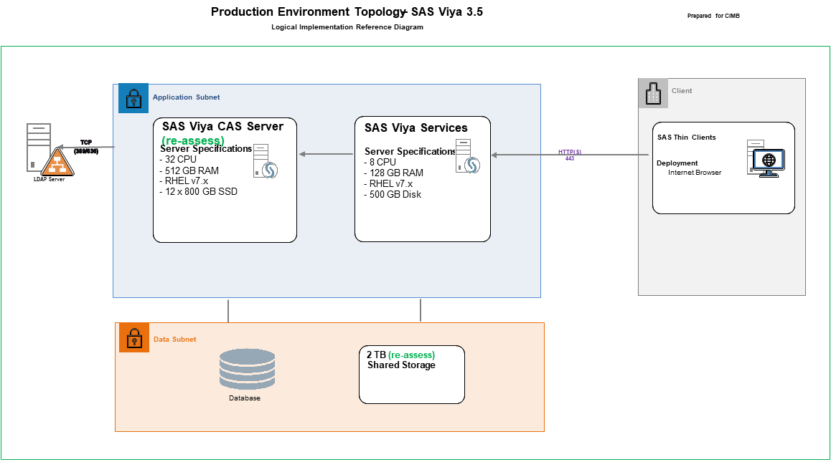
Option 1 – Dataset Segregation
Deploy On-Premise –SMP
SAS Viya3.5 – PRODUCTION
CIMB to import csv to SAS datasets
CIMB to filter and segregate sensitive datasets to respective folder directories based on the 15 Groups
SAS to enforce OS/folder directories access rights based on 15 Groups
SAS to align the User Groups' datasets based on OS/folder directories and create respective LIBRARIES per User Groups to enforce data access rights within Viya
PROs
Permissions and access rights are on directories, libraries and physical datasets.
If the data sizes for the 15 Groups are within the capacity, there will be no need to increase SAS Viya’s server specifications. Disk/SFS’s storage for CIMB’s re-assessment.
Minimal SAS Services CR or no CR?
CONs
Multiple copies of dataset per User Group
Notes:
Additional considerations for DISK storage (SASHDAT/cas_disk_cache)
https://www.sas.com/content/dam/SAS/support/en/sas-global-forum-proceedings/2019/3351-2019.pdf
https://communities.sas.com/t5/SAS-Communities-Library/Provisioning-CAS-DISK-CACHE-for-SAS-Viya/ta-p/603689
Yammer post on similar use case: https://web.yammer.com/main/threads/eyJfdHlwZSI6IlRocmVhZCIsImlkIjoiMTY1MDYwNzQxOTM2NzQyNCJ9

Slide 17
Option 2:
UAM within SAS Viya

Slide 18
Option 2 – SAS Viya
Deploy On-Premise –SMP
SAS Viya3.5 – PRODUCTION
Data to be loaded in CAS (in-memory) and can be offloaded to DISK (SASHDAT) if not needed – for tables with sensitive information (14 tables)
Table, CLS and RLS will be done within CAS and SASHDAT level
For on boarding and updating the UAM:
Users will be based on AD integrated to Viya
Custom Groups will be created in SAS Environment Manager
The users will be aligned to respective Custom Groups
CLS and RLS rules need to be maintained in a table/file
Customized SAS scripts need to be created to:
Join tables to merge the columns required for RLS
Extract the User and Custom Groups
Use the CLS and RLS rules within a table as lookup
CLS with updSomeAcsColumn Action
RLS with updSomeAcsTable Action
CIMB to cater for data retention/housekeeping of the data
PROs
If data can fit in CAS/SASHDAT, no need to expand memory and cores of SAS Viya
Business users can access the data directly within SAS Viya applications with the desired access rights
CONs
If data is larger than the memory (435GB) then performance will degrade.
Additional considerations for DISK storage (SASHDAT/cas_disk_cache)
SAS Services scoping for implementation
Notes:
Additional considerations for DISK storage (SASHDAT/cas_disk_cache)
https://www.sas.com/content/dam/SAS/support/en/sas-global-forum-proceedings/2019/3351-2019.pdf
https://communities.sas.com/t5/SAS-Communities-Library/Provisioning-CAS-DISK-CACHE-for-SAS-Viya/ta-p/603689
Yammer post on similar use case: https://web.yammer.com/main/threads/eyJfdHlwZSI6IlRocmVhZCIsImlkIjoiMTY1MDYwNzQxOTM2NzQyNCJ9

Slide 19
Option 2 – SAS Viya (CAS)
Approach
Data to be loaded in CAS (in-memory) and can be offloaded to DISK (SASHDAT) if not needed for 14 TABLES
Table, CLS and RLS will be done within CAS and SASHDAT level
For on boarding and updating the UAM:
Users will be based on AD integrated to Viya
Custom Groups will be created in SAS Environment Manager
The users will be aligned to respective Custom Groups
CLS and RLS rules need to be maintained in a table/file
Customized SAS scripts need to be created to:
Join tables to extract the columns required for RLS
Extract the Custom Groups from the Environment Manager
Use the CLS and RLS rules within a table and the Custom Groups as lookup
CLS with updSomeAcsColumn Action
CLS with updSomeAcsColumn Action
RLS with updSomeAcsTable Action
RLS with updSomeAcsTable Action
Create scripts to do append/refresh/maintenance of the tables. ???
Notes:
https://go.documentation.sas.com/doc/en/vdmmlcdc/8.1/caspg/p0hl1p1jnrmna0n1hx4lz5hbak8p.htm
Access Control Action Set: Examples
Set a Dynamic Row-Level Filter
https://go.documentation.sas.com/doc/en/vdmmlcdc/8.1/caspg/p0swbnki9gy5iin1lgzku3w6euqx.htm
Hide a Column from Most Users
Get list of all users and their Viya custom groups
https://communities.sas.com/t5/Administration-and-Deployment/SAS-VIYA-Fetching-List-of-Users-Groups-Creation-Date/td-p/723793
https://communities.sas.com/t5/SAS-Viya/Get-list-of-all-users-and-their-Viya-custom-groups/m-p/637761

Slide 20
Option 3:
Dedicated Database within CDM

Slide 21
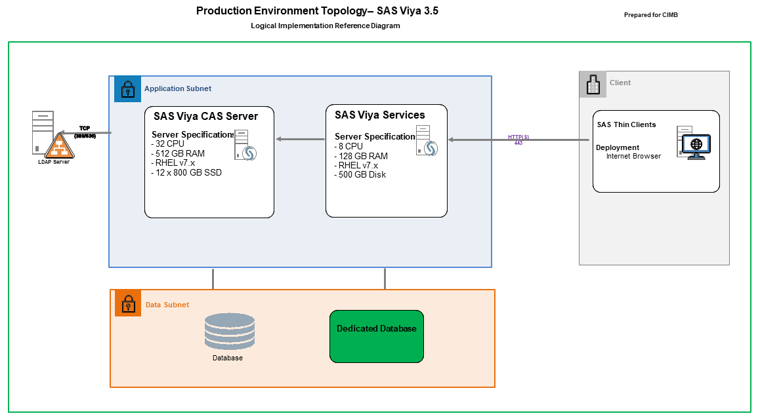
Option 3 – Dedicated Database
Deploy On-Premise –SMP
SAS Viya3.5 – PRODUCTION
CIMB to provision a dedicated DB within CDM and integrate with SAS Viya
CIMB’s DB Administrator to implement table, CLS and RLS within the DB
The UAM rules set will be based on User Groups
SAS will align the DB User Groups with SAS Viya User Groups and create respective LIBRARIES per User Groups to enforce data access rights within Viya
PROs
Best practice is to house all historical data in a DB to achieve complex security requirements
On-boarding and maintenance of new users and groups will be within a UI within the DB management.
SAS Viya can integrate with the DB to align with the Group access controls.
All Business Users (non-SAS users) can be granted access to the DB , depending on their group permissions.
Third party applications can directly integrate with the DB
Minimal SAS Services CR or no CR?
CONs
Requires new server and DB license.

Slide 22
Option 3 – Dedicated Database
Approach
CIMB’s scope:
CIMB to get a dedicated DB for CDM – Viya
UAM will be created and managed within the database
Table level security, Column Level Security (CLS), Row Level Security (RLS) will be managed within the database
SAS’ scope:
To align within Viya the Auth Domain / Groups created in DB by CIMB

Slide 23
Option 3 – Dedicated Database
Approach
There will be a corresponding Library (Compute/CAS) tied to a Group
SAS Viya runtimes and data connections. Example:
Compute/SPRE:
orasaslib1 ~ OraAuth1
orasaslib2 ~ OraAuth2
orasaslibx ~ OraAuthx
CAS:
oracaslib1 ~ OraAuth1
oracaslib2 ~ OraAuth2
oracaslibx ~ OraAuthx
Where:
CIMB Group1 = OraAuth1 for Oracle Group1 (Orauser1, Orauser2, Orauser3)
CIMB Group2 = OraAuth2 for Oracle Group2 (Orauser5, Orauser6, Orauser1)

Slide 24
Thank You

Slide 25
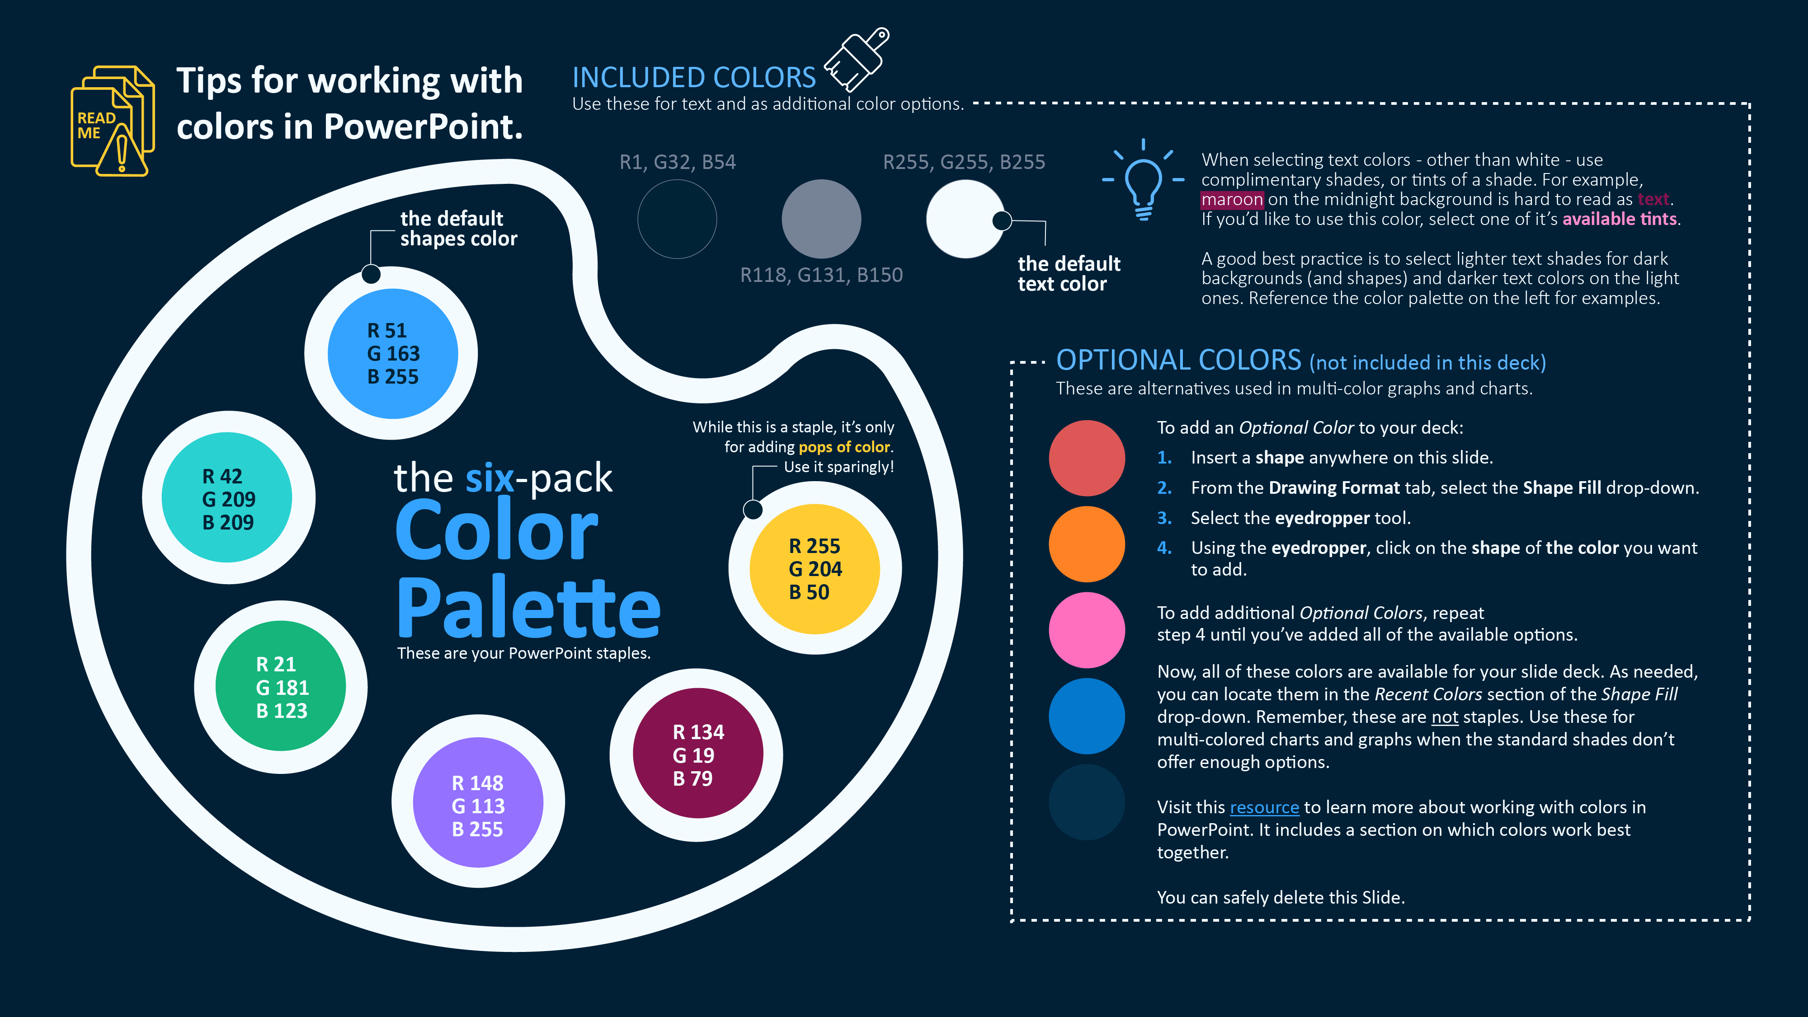

Slide 26
